Slide 1
Predicting the number of Twitter followers
Group 3
Chern Cheng | 01354502
Sun Yifan | 01461236
Tean Wan Ching | 01462626
Yue Zixuan | 01475299
Zhang Erhe | 01475073

Slide 2

Introduction & Content
Predicting the expected number of Twitter followers for US corporations in 2017.
Overview of models
Data preparation and cleaning
Fitting model and prediction
Summary

Slide 3

Overview of models
Train data: 2017/01/01 - 2017/06/30
Test data: 2017/07/01 - 2017/09/30
Dependent variable: daily growth rate of number of followers
(assume that there is no increase in followers for the missing dates)
Financial model
Non-financial model
Combined model
Lasso, Xgboost & Random Forest
Ensemble model
Predict

Slide 4


Data preparation and cleaning - Outlier management
6 companies don’t have twitter account, they are either acquired or bankrupted
Remove them from train and test data
Fill in their number of follower
Merge these six companies back to the test data with predicted followers
Fill in with the latest available number of followers (2017/06/30)
Fill in with the estimated number of followers based on growth rate calculated with train data
Daily growth rate from 03/31 to 06/30
*
Number of followers on 06/30

Slide 5
Data preparation and cleaning – Financial data
Stock price related vars (daily)
p_daily_change, volatile
Financial ratios (monthly)
Total asset (quarterly)
Sayed, D. E. (n.d.). The effect of financial ratios on Twitter sentiment and volume.

Slide 6
Data preparation and cleaning – Financial data
Stock price related vars (daily)
Fill NA with last closing price - Weekends/PH
Fill NA with 0 - for firm w/o stock info
Create lag variables by one day
Financial ratios (monthly)
1. Fill in with computed quarterly financial ratio
2. Fill in with monthly industry median (full companies)
3. Fill in with industry median (full companies)
4. Fill in with total median (full companies)
5. Create lag variables by one month
6. Populate to data on a daily basis
Total Asset (quarterly)
Fill NA with quarterly industry median and populate
bm = book value of equity /mkt value of equity = teqq/ mkvaltq
pe_exi = price to earnings (excluding ei) = epsfxq
ps = mkt value of equity /sales = mkvaltq/saleq
pcf = mkt value of equity /net cashflow = mkvaltq/ ((fincfy + ivncfy + oancfy)/ cshoq)
dpr = dividend payout ratio = dvpq / niq
npm = net income /sales = niq / saleq
opmbd = oper inc before depreciation/sales = oibdpq/saleq
opmad = oper inc after depreciation/sales = oiadpq/saleq
gpm = gross profit/sales = ugiq/saleq
roa = net income/ total assets = niq/atq
roe = net income/ book equity = niq/teqq
roce = ebit/capital employed = ibmiiq/icaptq
debt_asset = total debt/ total assets = (dlttq+dlcq)/atq
de_ratio = total liabilities /shareholders equity = ltq/teqq
int_cov = after tax income/interest & related exp = niq/tieq
cash_ratio = cash curr liabilities = cheq/lctq
quick_ratio = curr assets (net of inventory)/curr liabilities = (actq-invfgq)/lctq
curr_ratio = curr assets/curr liabilities = actq/lctq
inv_turn = cogs/inventory = cogsq/invfgq
at_turn = sales/total assets = saleq/atq
rect_turn = sales/total receivables = saleq/rectq
sale_nwc = sales/working capital = saleq/wcapq
ptb= mkt equity to book value of equity = mkvaltq/teqq

Slide 7
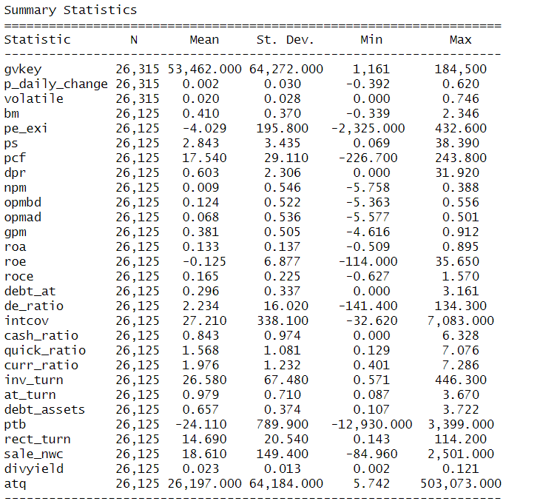
Data preparation and cleaning – Financial data
26315 – 26125 = 190
NA 190 of financial ratio are those data on 2016/12/29 and 2016/12/30 for creating lag variables for stock daily change and volatile. If divided by 2, it is just the number of unique gvkey 95

Slide 8
Data preparation and cleaning – Non-Financial data
Company’s announcements (daily)
is_announce, red_announce, number_annoucement
Profile data (fixed)
Tsileponis, N., Stathopoulos, K., & Walker, M. (2020). Do corporate press releases drive media coverage? The British Accounting Review, 52(2), 100881. https://doi.org/10.1016/j.bar.2020.100881

Slide 9

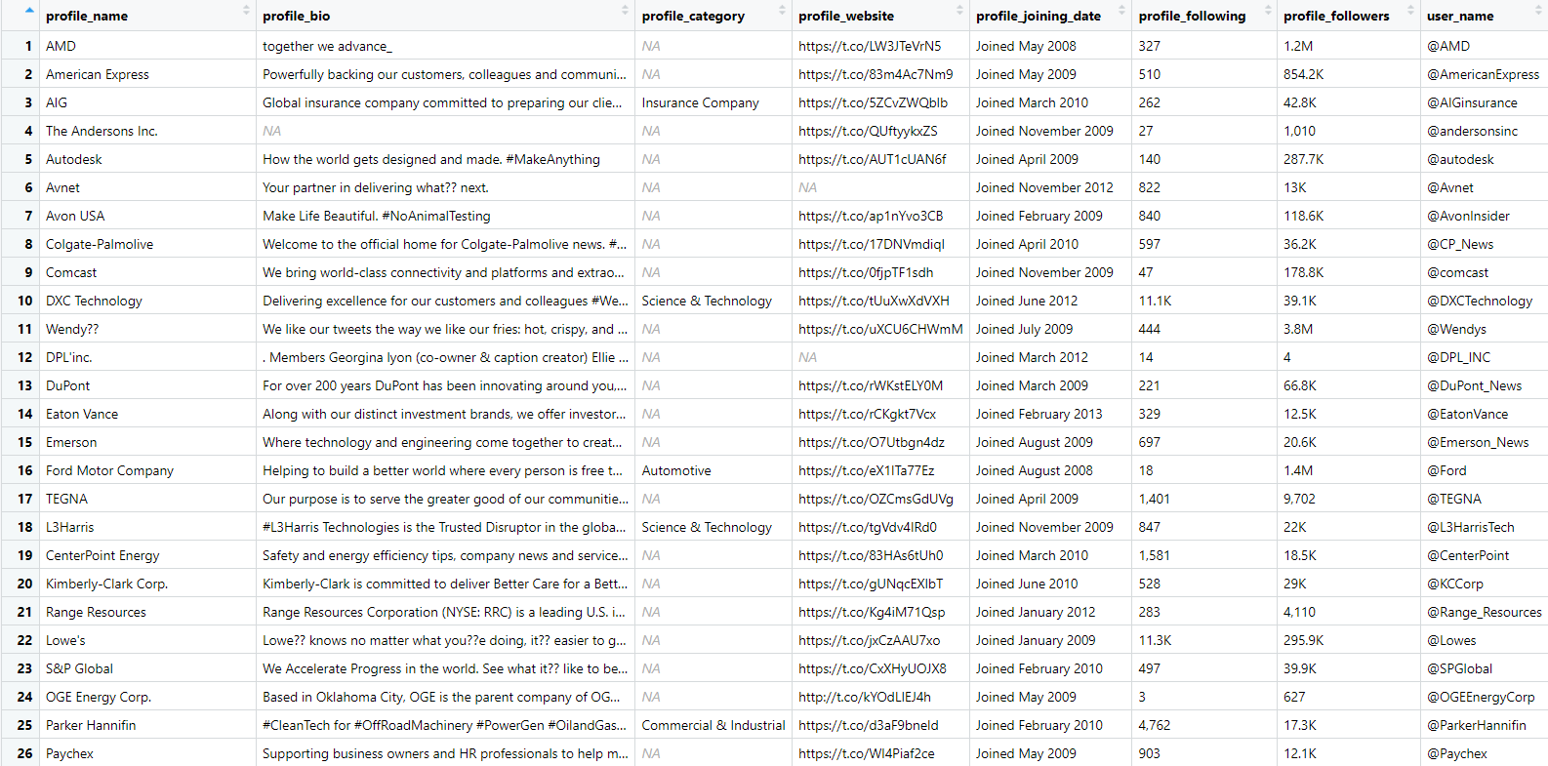
Data preparation and cleaning – Non-Financial data
Company’s announcements (daily)
is_announce, red_announce, number_annoucement
Profile data (fixed)
profile_handle
profile_bio
category, URL, join_date
following, follower
Hutto, C. J., Yardi, S., & Gilbert, E. (2013). A longitudinal study of follow predictors on twitter. Proceedings of the SIGCHI Conference on Human Factors in Computing Systems, 821–830. https://doi.org/10.1145/2470654.2470771

Slide 10
Data preparation and cleaning – Non-Financial data
Company’s announcements (daily)
is_announce, red_announce, number_annoucement
Profile data (fixed)
1. TFF (followers and followee ratio)
Replace those followee = 0 with 1
2. readability of profile bio (flesch score, coleman lieu, FOG)
fill NA with industry median – total median
3. no.of words of bio (0 for no profile bio)
4. profile completeness
5. has_url
6. No of Hashtags
7. has_hashtags
8. user_name categories ("contains_company_name ", "contains_words", “custom_content“)
9. joined Twitter duration ("days_joined", "months_joined", "years_joined")
contains_company_name
American express co
@AmericanExpress
contains_words
Charles river labs intl inc
@CRiverLabs
custom_content
Advanced micro devices
@AMD
Mueller, J., & Stumme, G. (2017). Predicting Rising Follower Counts on Twitter Using Profile Information. Proceedings of the 2017 ACM on Web Science Conference, 121–130. https://doi.org/10.1145/3091478.3091490

Slide 11
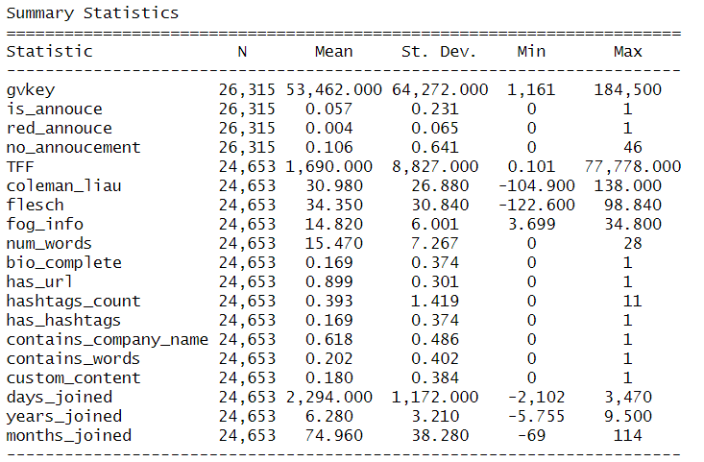
Data preparation and cleaning – Non-Financial data
26315 – 24653 = 1662
NA 1662 are profile data for the 6 companies that don’t have twitter account, if divided by 6, it’s just the number of days from 2016/12/29 to 2017/10/01

Slide 12
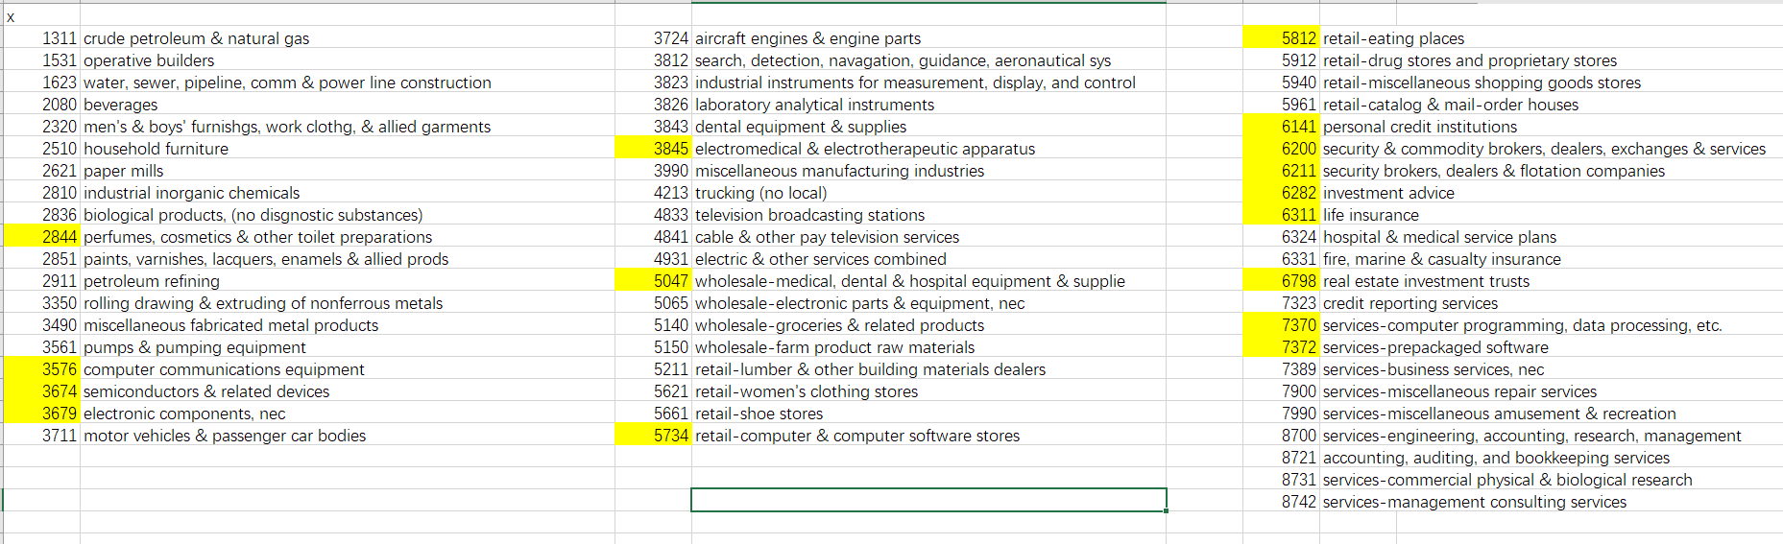
Data preparation and cleaning – Other variables
pop_ind (dummy variable)
Week dummy variables
is_mon, is_tue, is_wed, is_thu, is_fri, is_sat

Slide 13
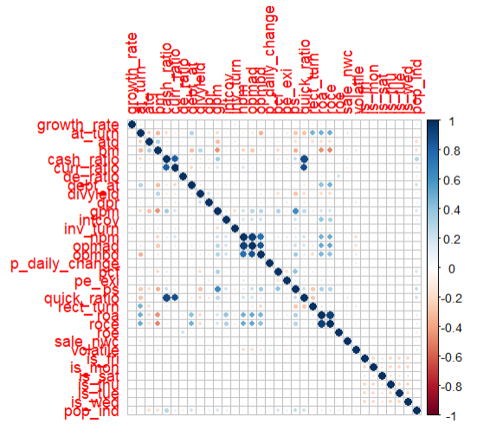
Financial model
Multicollinearity test: correlation matrix
3 pairs of highly correlated variables :
-Return on Assets (roa)
Return on Capital Employed (roce)
-Cash Ratio (cash_ratio)
Quick Ratio (quick_ratio)
-Net Profit Margin (npm)
Operating Income Before Depreciation (opmbd)
Operating Income After Depreciation (opmad)
Build same 6 models by only keep one of the variables for each pair

Slide 14
Financial model
Six Financial Models
Model1: Financial ratios + stock price (daily changing rate and daily volatile) + industry dummy (popular industry = 1) + week dummy + log (asset)
Model2: Financial ratios lag value + stock price (daily change rate and daily volatile) + industry dummy (popular industry = 1) + week dummy + log (asset)
Model3: Financial ratios + stock price (daily change rate and daily volatile) + industry dummy (popular industry = 1) + week dummy + log (asset) + industry fixed effect
Model4: Financial ratios lag value + stock price (daily change rate and daily volatile) + industry dummy (popular industry = 1) + week dummy + log (asset) + industry fixed effect
Model5: Financial ratios value + stock price (daily change rate and daily volatile) + industry dummy (popular industry = 1) + week dummy + log (asset) + industry fixed effect +firm fixed effect
Model6: Financial ratios lag value + stock price (daily change rate and daily volatile) + industry dummy (popular industry = 1) + week dummy + log (asset) + industry fixed effect +firm fixed effect

Slide 15
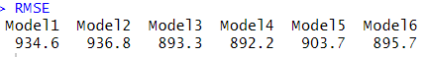
Financial model
RMSE comparison for all 12 models – In Sample Accuracy
RMSE with all financial ratio variables
RMSE after removing highly correlated variables
Model4 returns the lowest RMSE with all financial ratio variables include.
Model9 returns the lowest RMSE after removing highly correlated variables.
If compare in group level, almost all 6 models in sample accuracy become worse after removing the highly correlated variables except model 5.
So we keep all these 12 models to check the out of sample accuracy.

Slide 16
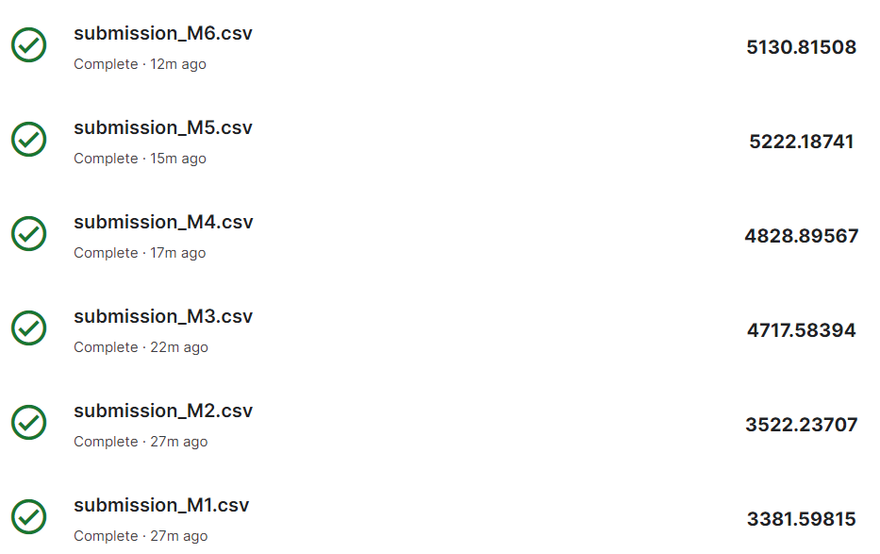
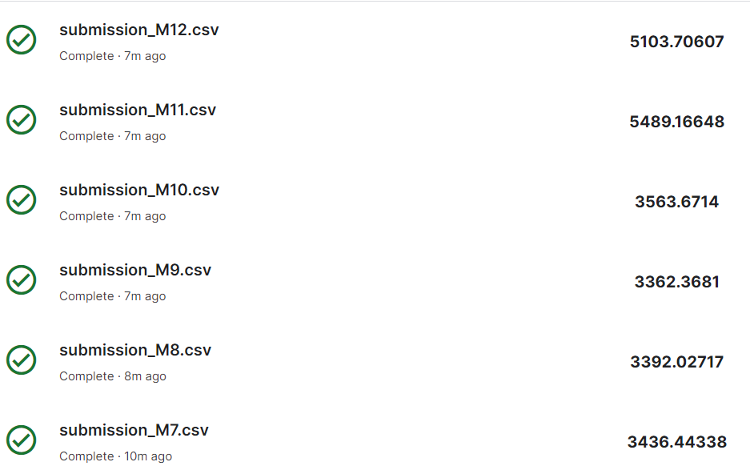
Financial model
Kaggle Score comparison for all 12 models – Out of Sample Accuracy
In 1st group, Model1 gets the best Kaggle Score instead of Model4 (lowest RMSE)
In 2nd group, Model9 gets the best Kaggle Score also lowest RMSE
Overall, Model 4 is the best model for in sample data. Model9 is the best model for out of sample data.
→ Model 9 has higher bias but lower variance
Rank no.4 in the leaderboard on Kaggle for Financial model

Slide 17
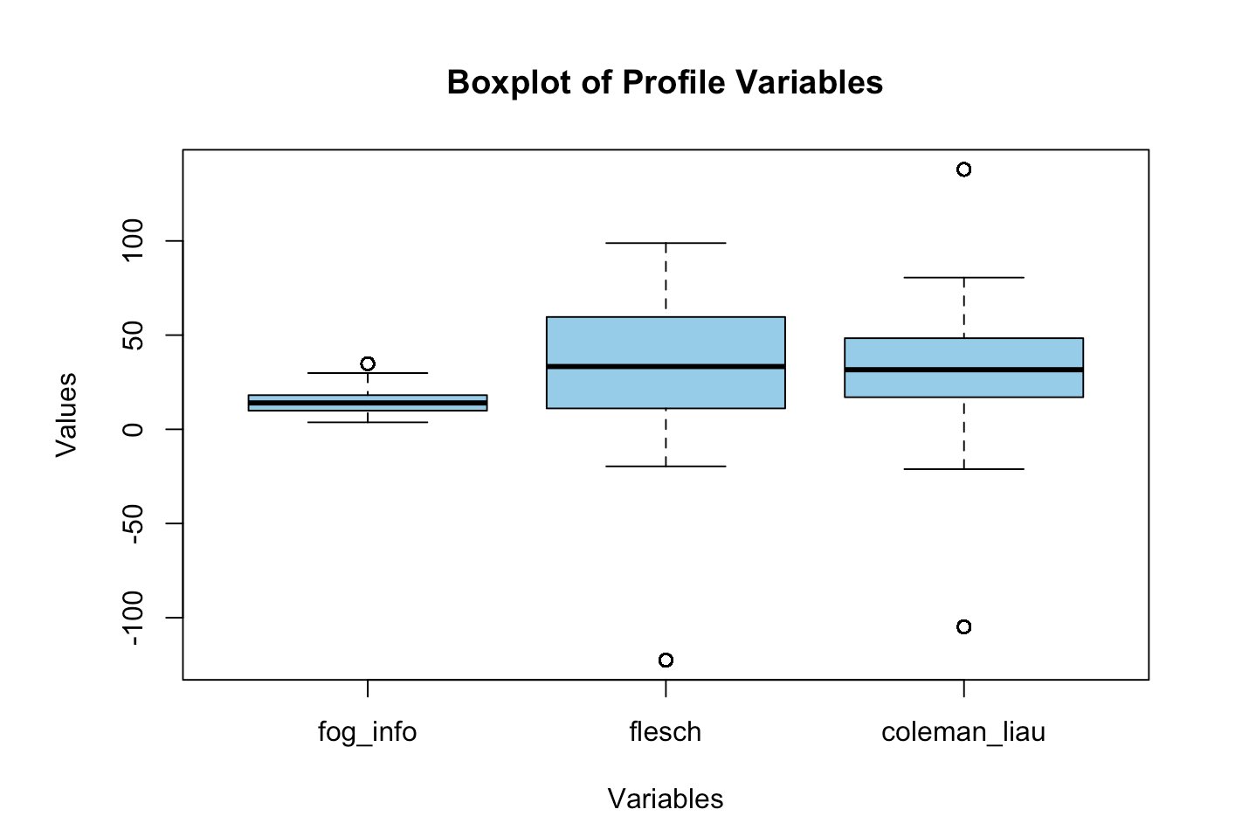
Non-Financial Model Visual Analysis of Profile Bio Readability
fog_info: lower Fog Index indicates that the text is easier to read.
Fog Index: Approx. 15
flesch: higher score indicates text that is easier to read.
Flesch score: Approx. 30
Wide range
Outliers: differences languages
coleman_liau: score represents the grade level required to understand the text.
Coleman-Liau index: Approx. 25
Outliers: differences languages

Slide 18
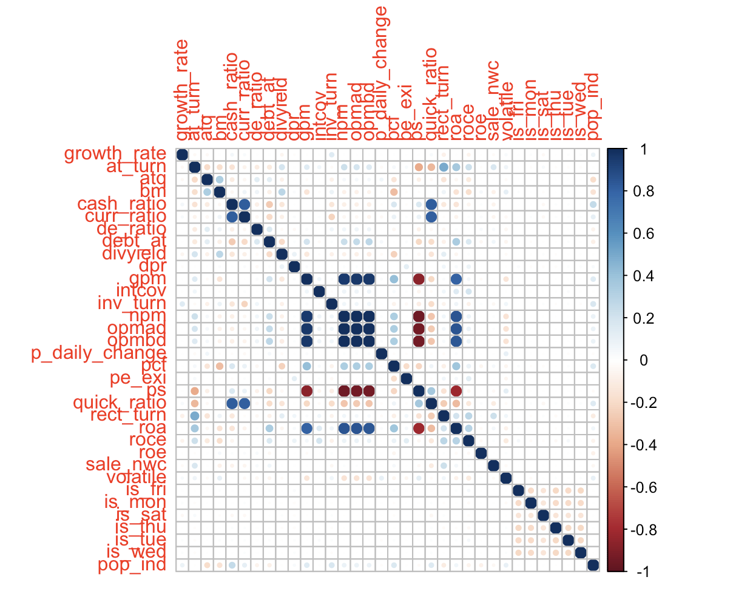
Non-Financial Model Multicollinearity Test
days_joined, months_joined and years_joined are highly correlated.
only retain days_joined variable in the construction model.
days_joined variable has greater variability.

Slide 19
Non-Financial Model
Model 13:
Profile vars + announcements vars + popular ind + week dummy + ln(asset)
Model 14:
Profile vars + announcements vars + popular ind + week dummy + ln(asset) + industry FE
Model 15:
Profile vars + announcements vars + popular ind + week dummy + ln(asset) + industry FE + firm FE
Models use the same set of dependent and independent variables, The differences is on the fixed effect levels.

Slide 20
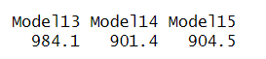
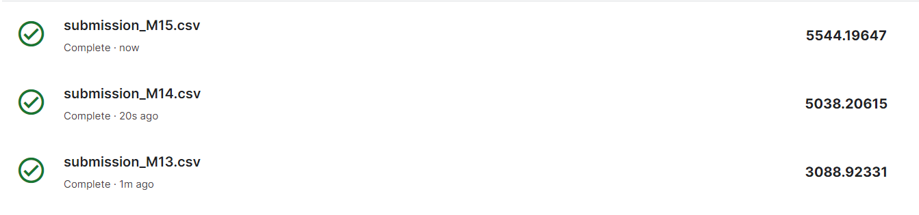
Non-Financial Model RMSE comparison – In Sample Accuracy Model 14 gives the best result. Model 13 has highest RMSE, overfitting the training data.
Kaggle Score comparison – Out of Sample Accuracy
Model 13 gives the best result, which rank 3rd on the Kaggle leaderboard.
Model 13 generalizes well and is effective at making predictions on new, unseen data.

Slide 21
Combined Model
The 5 combined models constructed are as follows:
combined_Model 16 :
growth_rate = financial ratios + stock price + announcements + profile variables + ln(asset)
combined_Model 17 :
growth_rate = ln(financial ratios) + ln( stock price) + announcements + profile variables+ ln(asset)
combined_Mode 18 :
Remove variables with high multicollinearity
opmad, npm, quick_ratio, cash_ratio, ps, ptb, and roce
combined_Model 19 :
growth_rate = financial ratios + stock price + announcements + profile variables + ln(asset)
+ industry FE + firm FE
combined_Model 20 :
growth_rate = ln(financial ratios) + ln( stock price) + announcements + profile variables+ ln(asset) + industry FE + firm FE

Slide 22
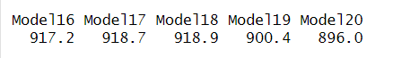
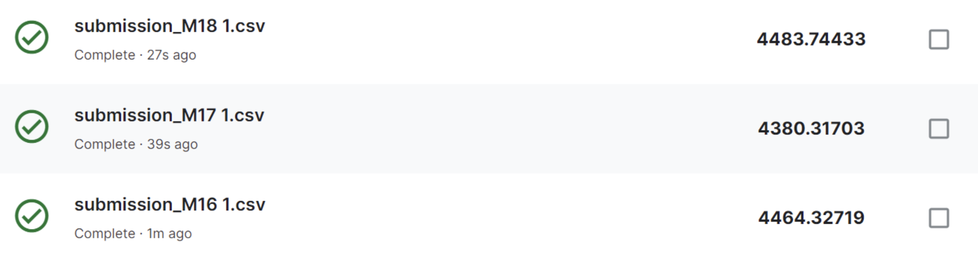
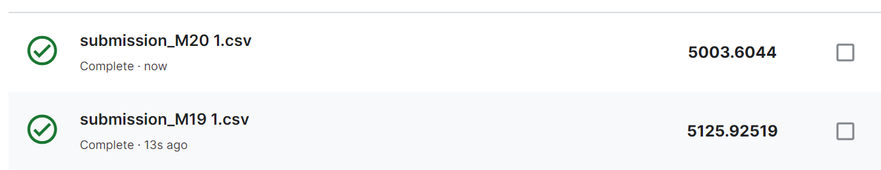
Combined Model RMSE comparison – In Sample Accuracy
Model 20 gives the best result.
Kaggle Score comparison – Out of Sample Accuracy
Model 17 gives the best result.

Slide 23
Model Selection for LASSO, XGBoost and Random Forest
ML_Mod21 : stock price and financial ratios model
ML_Mod22 : stock price (lag), financial ratios (lag) model
ML_Mod23 : announcement and profile variables model
ML_Mod24 : financial ratios, stock price , announcement, profile variables combined model
ML_Mod25 : financial ratios (lag), stock price (lag), announcement, profile variables combined model

Slide 24
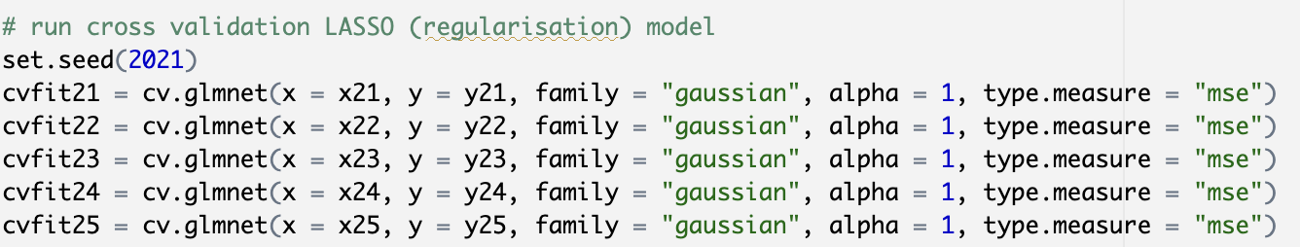
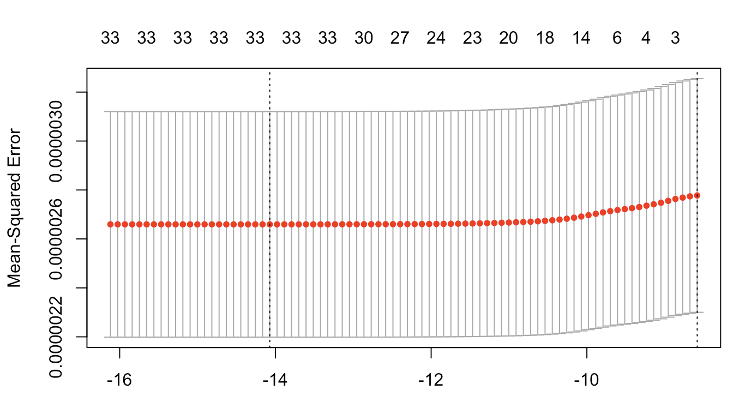
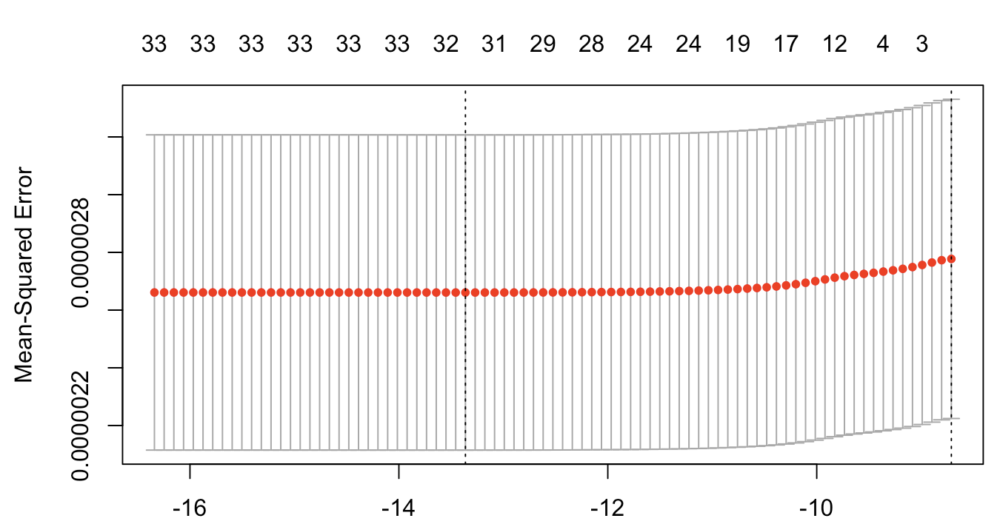
LASSO Cross Validation
cvfit21
cvfit22

Slide 25
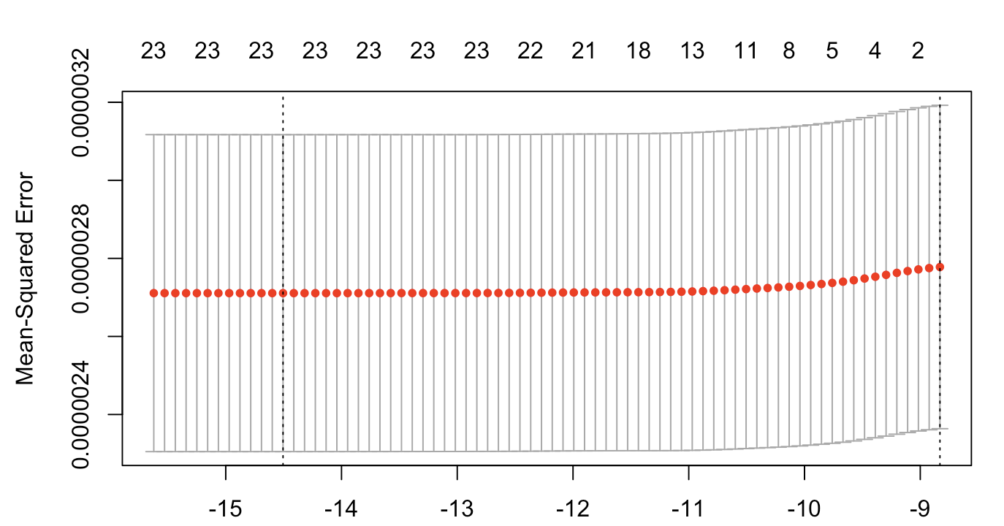
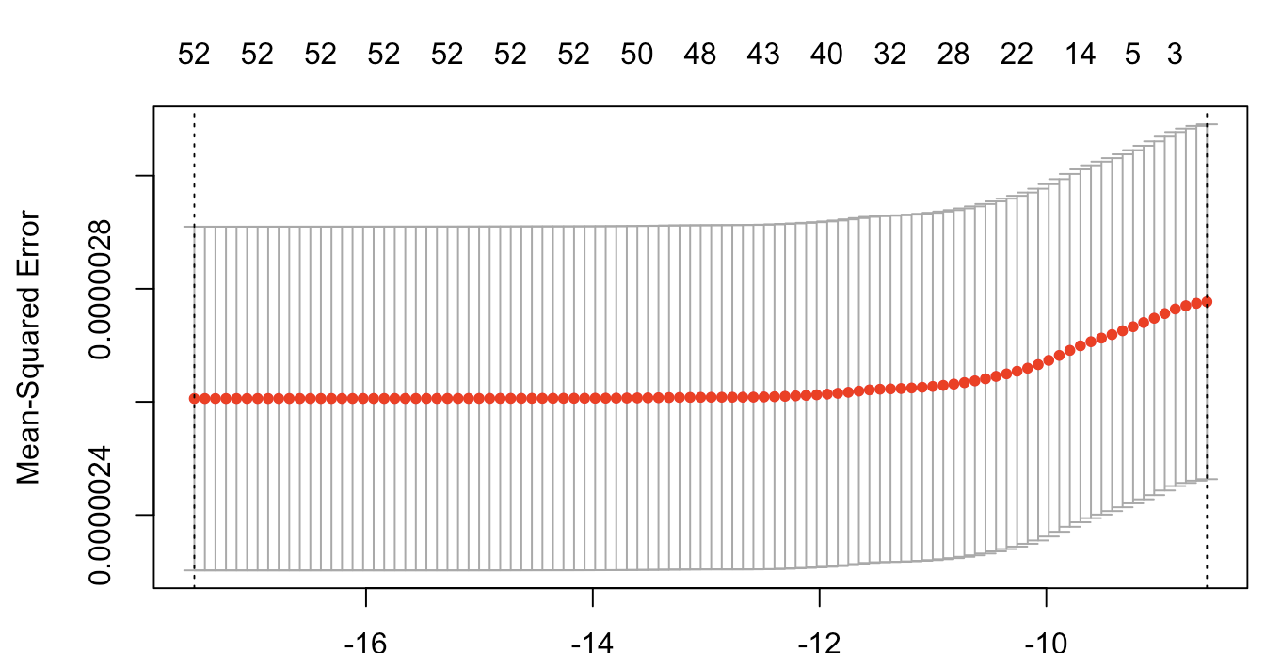
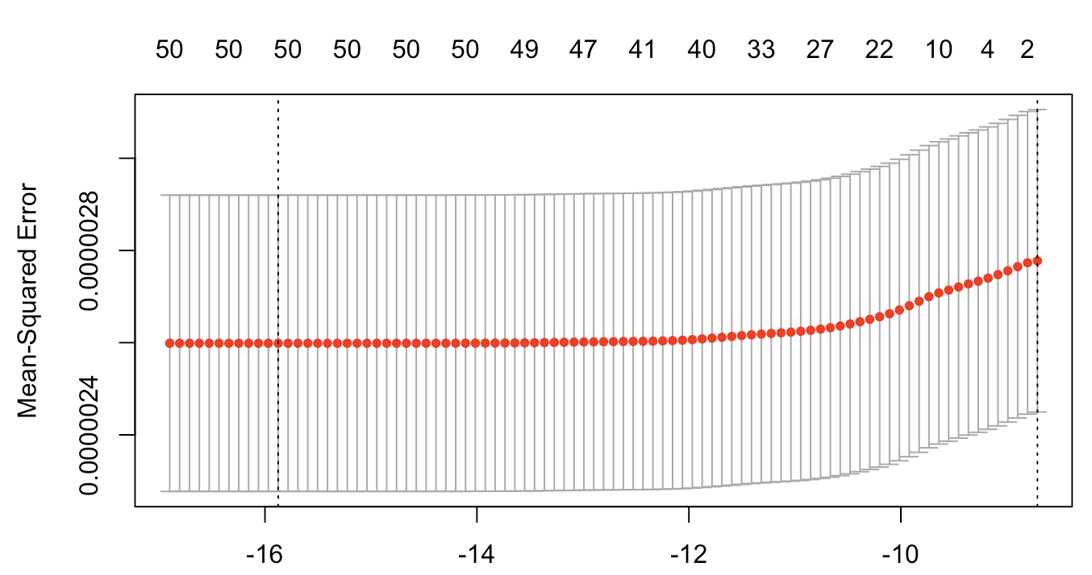
LASSO Cross Validation
cvfit23
MSE did not change much even with the removal of features
(shrinkage of coefficients) using LASSO.
incremental explanatory power of each feature is minimal.
features used in our model has explanatory power on its own
and when added together as a whole.
no incremental added explanatory power if we were to
consider feature by feature addition.
cvfit24
cvfit25

Slide 26
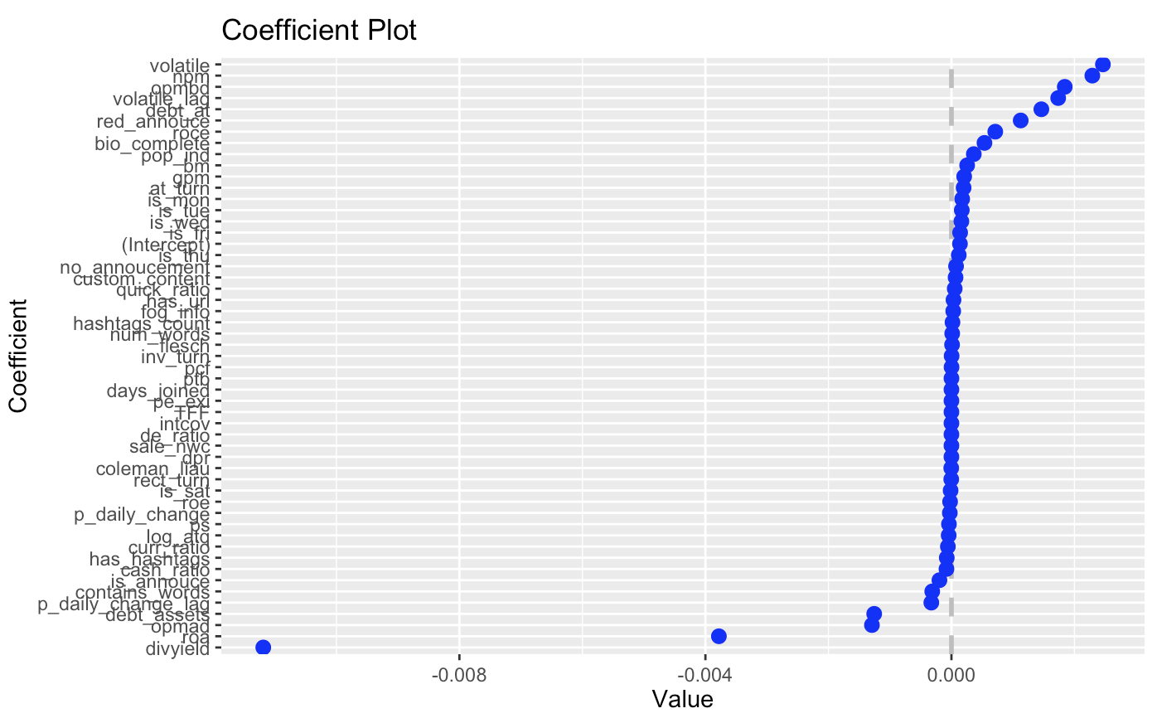
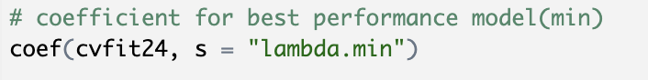
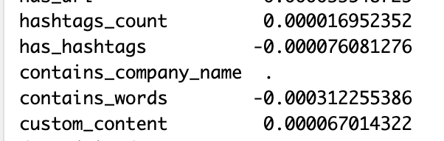
LASSO Feature Selection
cvfit24 Lambda.min (Best Performance Model) : 0.0000007735
cvfit25

Slide 27
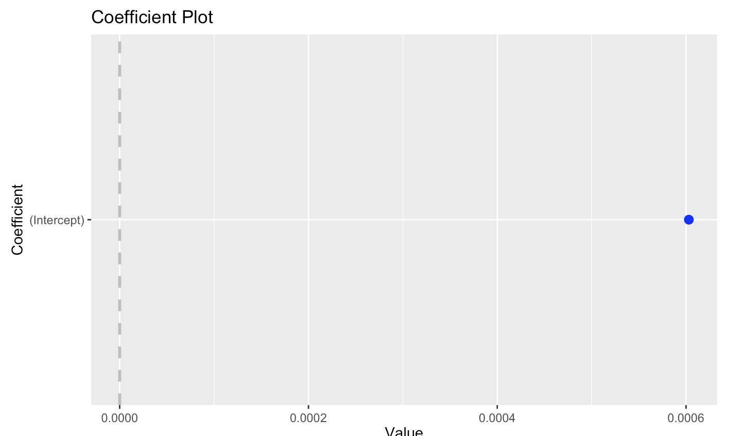
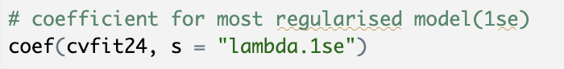
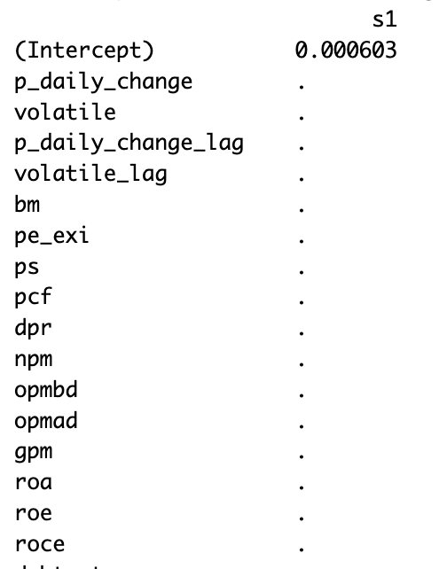
LASSO Feature Selection
Lamda.1SE (Most Regularised Model) : 0.0001872

Slide 28
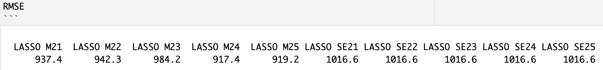
LASSO In Sample Evaluation
lamda.min returns a lower in sample RMSE (i.e. LASSO M21 - M25) while lamba.1SE returns a higher in sample RMSE.
lamda.1SE results are not meaningful since it retains only the y-intercept for prediction and we will not use it for out of sample prediction.

Slide 29
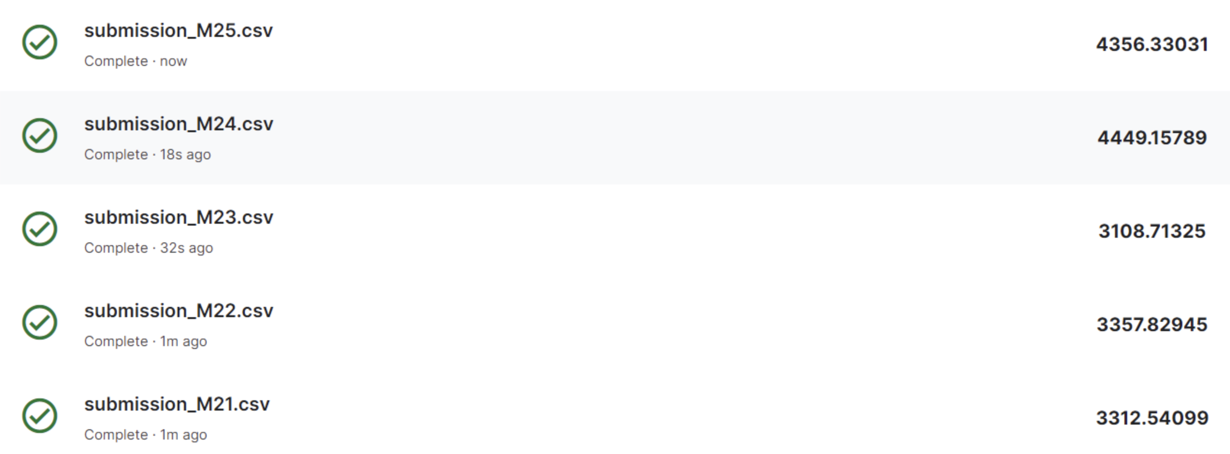
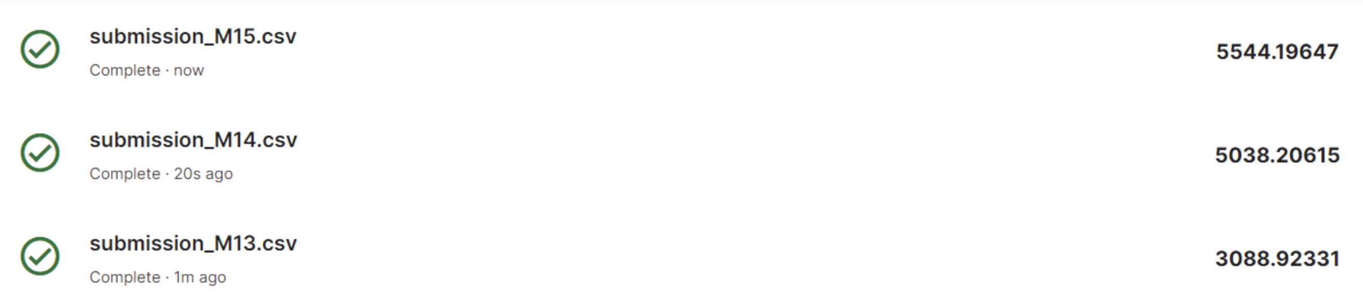
LASSO Out of Sample Evaluation
LASSO did not outperform non financial model for out of sample prediction
LASSO
Feature selection by LASSO is not effective in improving our out of sample prediction due to the small incremental effect of our features on MSE.
Domain knowledge model, on the other hand, uses all features and helps to retain explanatory power of each features when added as a whole. This in turn, make better out of sample prediction compared to LASSO regularised models.
Non Financial model

Slide 30
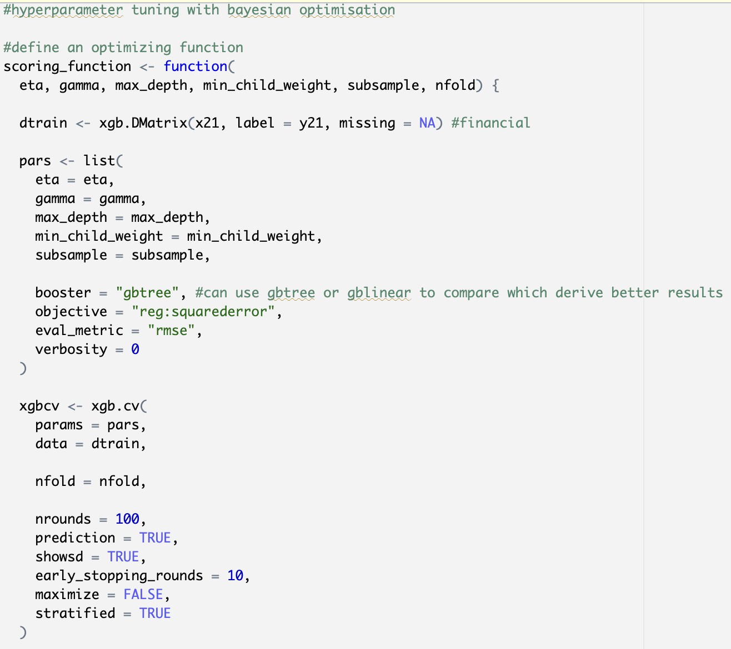
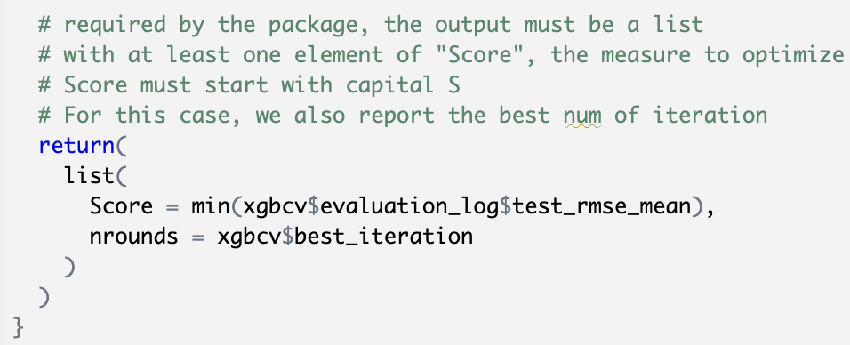
XGBoost Hyperparameter Tuning - Bayesian Optimisation

Slide 31
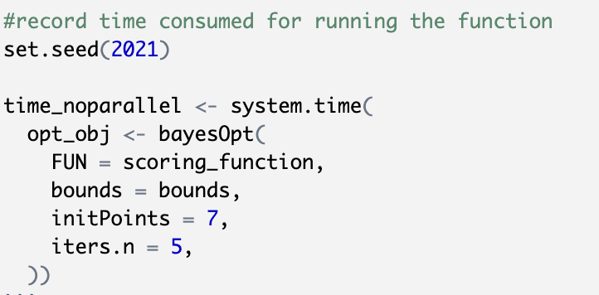
XGBoost Hyperparameter Tuning - Bayesian Optimisation
FUN : scoring function for optimization
bounds : boundary values for all parameters
initPoints : initialized the optimization process by running FUN number of times, the value must be more than the number of FUN inputs (for this case, FUN has 6 inputs, so this value should be at least 7)
iters.n : times FUN to run after initialization to search for global optimal solutions.

Slide 32
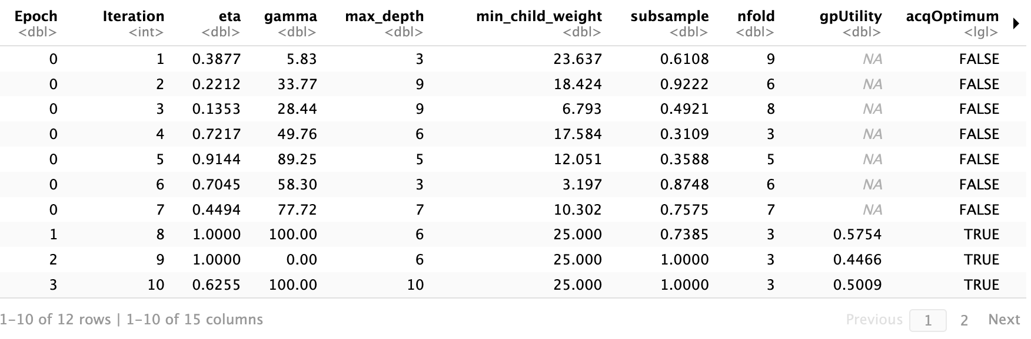
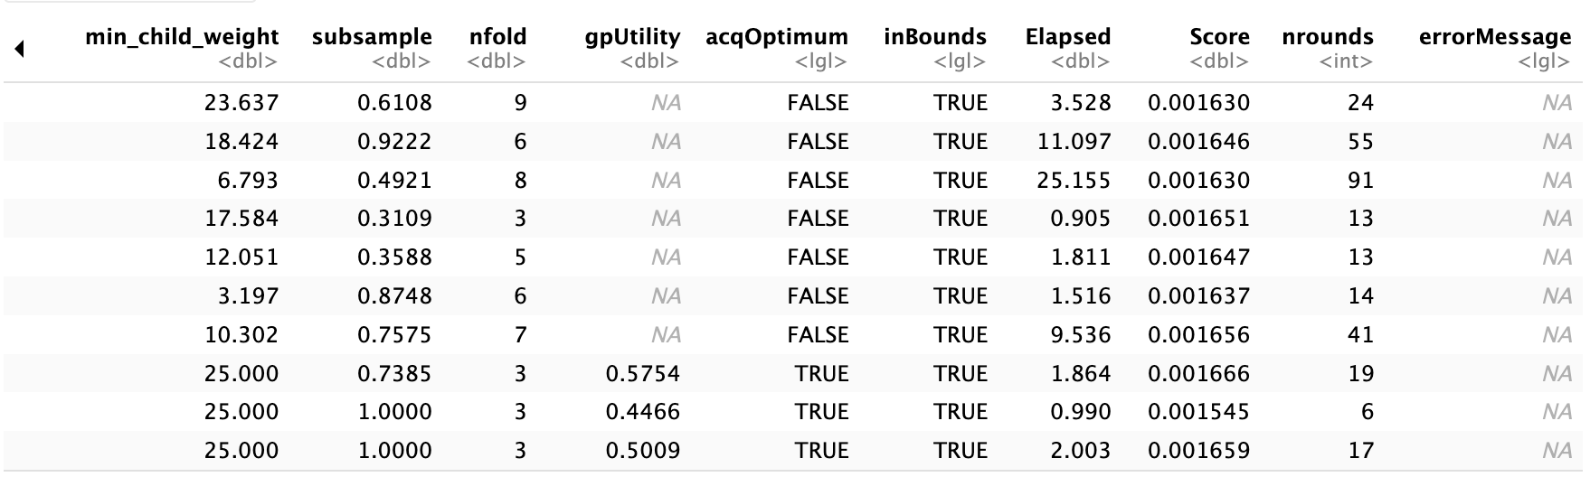
XGBoost BayesOpt Score Summary
- 9th iteration derives
parameters with the
lowest Score
- Input the 6 parameters as
optimized parameter for
training the XGBoost
models.
- The trained models will
then create predictions
with the lowest RMSE
within the boundaries we
have set for our parameters

Slide 33
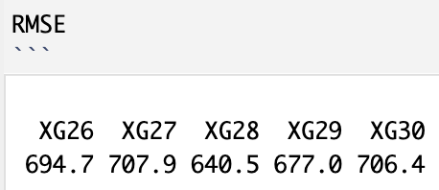
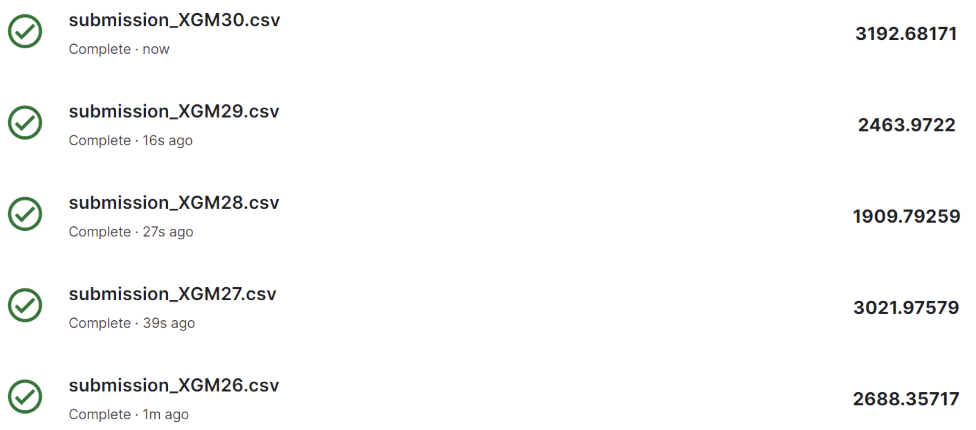
XGBoost In Sample & Out of Sample Evaluation
XG28 (Non financial model on XGBoost) performs the best in terms of in sample prediction with an in sample RMSE of 640.5.
Model that performs the worst for in sample prediction is XG27 (Financial(lag), StockPrice(lag) model on XGBoost).
XGM28 performs the best in terms of out of sample performance accuracy.
In fact, it outperforms all the other techniques LASSO and Random Forest in enhancing the accuracy of our models

Slide 34
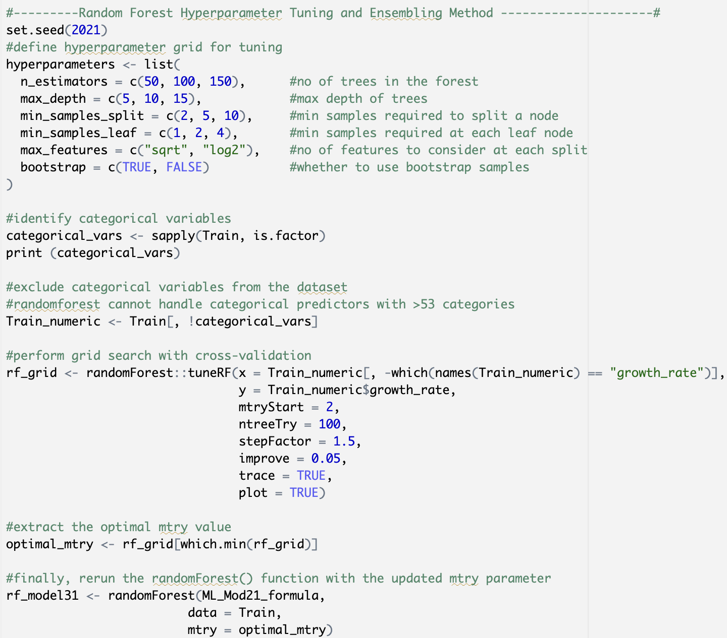
Random Forest Hyperparameter Tuning
randomForest::tuneRF :
Executes grid search with cross-validation using the tuneRF function, which automatically selects the optimal values for hyperparameters based on out-of-bag (OOB) error estimates.
Extract Optimal mtry Value: Identifies the optimal value for the mtry hyperparameter,
Represents the number of variables randomly sampled as candidates at each split.

Slide 35
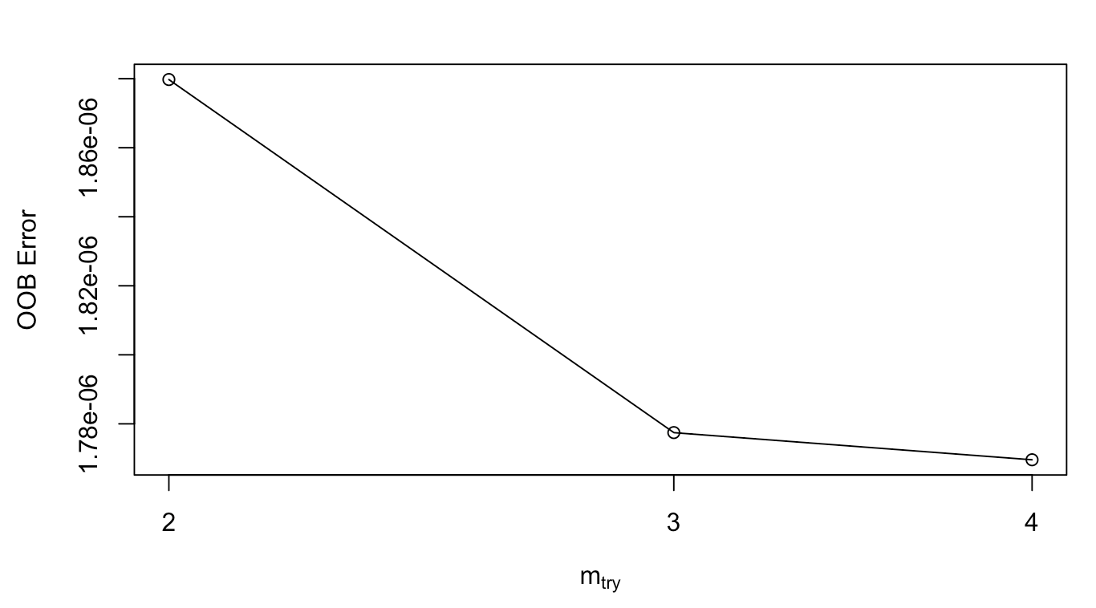
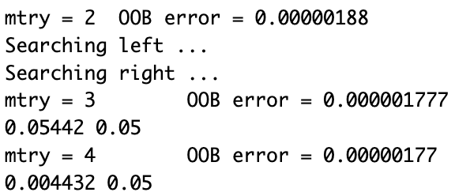
Optimal Mtry
Optimal Mtry that gives the lowest OOB error is 4

Slide 36
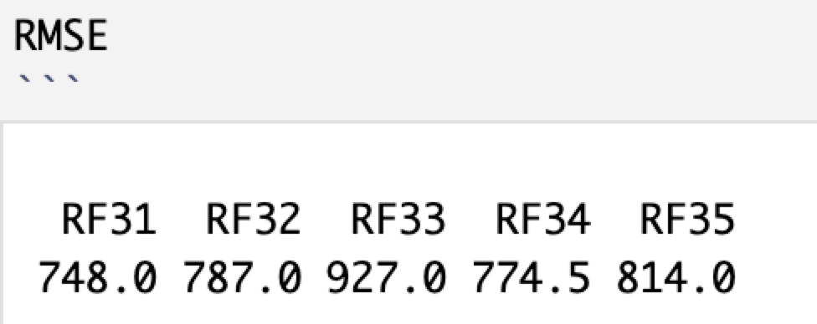
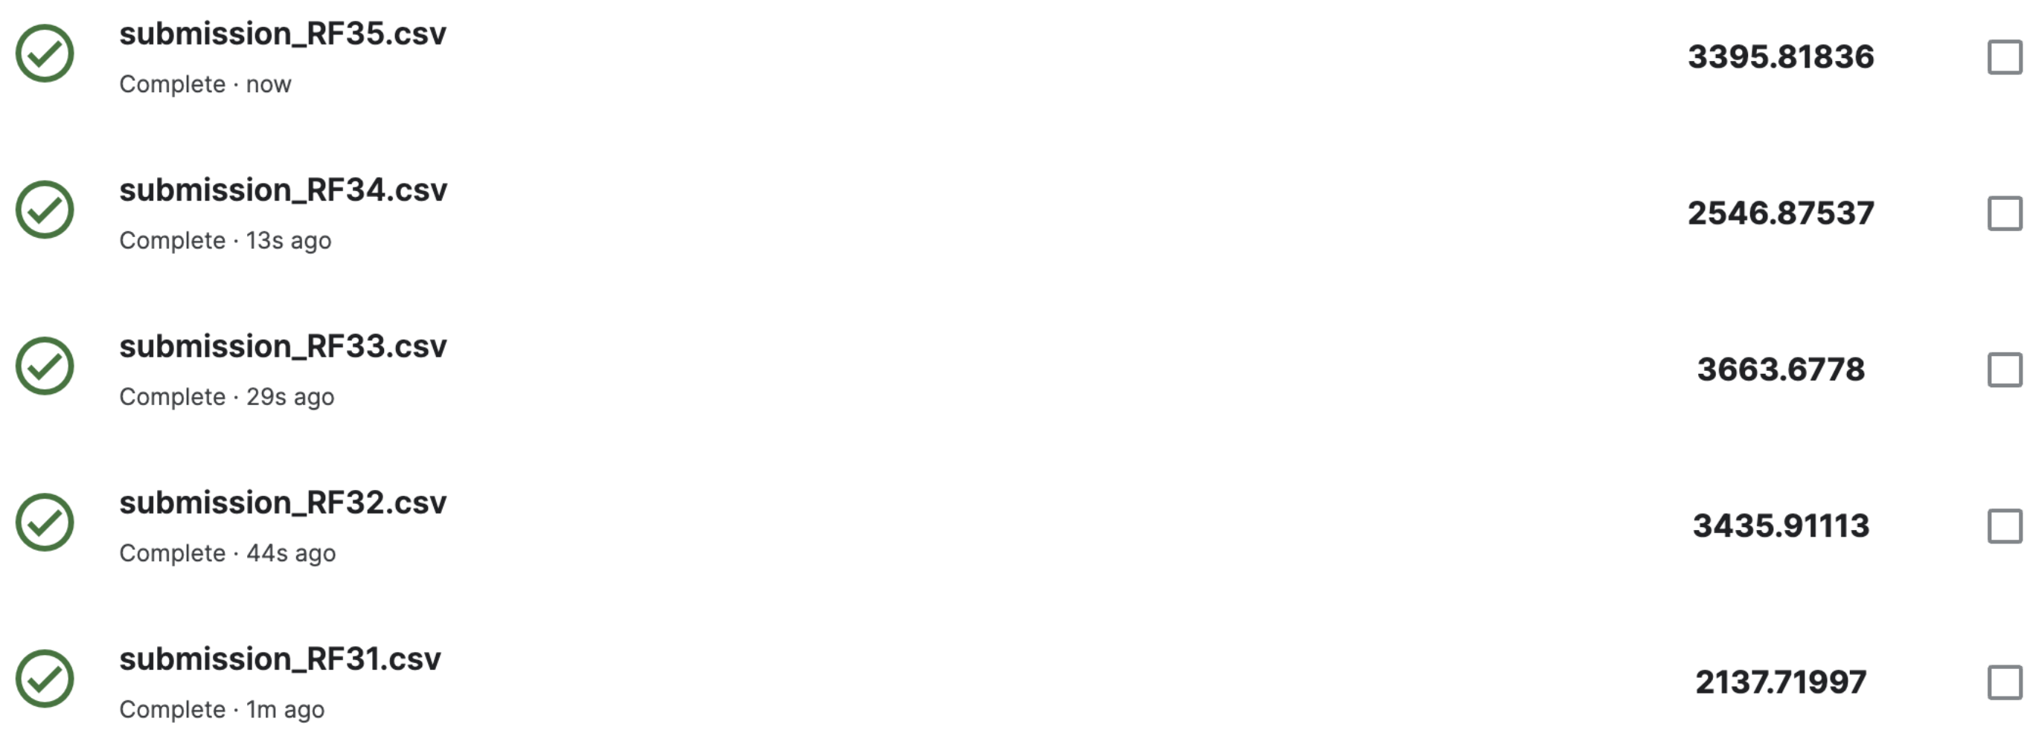
Random Forest In Sample & Out of Sample Evaluation
Random Forest succeeded in enhancing our domain knowledge model prediction accuracy
RF Model 31 (Financial Model) makes the best predictions out of sample
Financial ratios and Stock Price does have some explanatory power in predicting Twitter followers
Bootstrapping and bagging techniques in Random Forest is not as powerful as the boosting techniques used in XGBoost on enhancing prediction accuracy of our model
Notes:
RF Model 31 (Financial Model) makes the best in sample prediction with the lowest RMSE of 748.0.
RF Model 33 (Non Financial Model) performs the worst in terms of in sample prediction with the highest RMSE of 927.0.

Slide 37
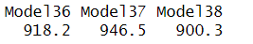
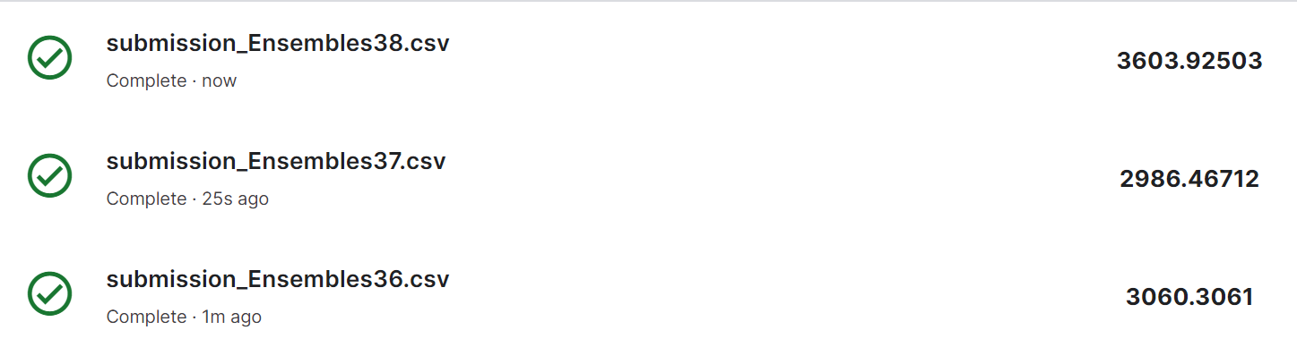
Ensemble by average
Average the financial model 3 and non-financial model 1 test prediction as the predicted growth rate
The RMSE of average predictions in train data is 918.23
Kaggle result shows that the Ensemble by average significantly improves the model and its rank is higher than non-financial model 3

Slide 38
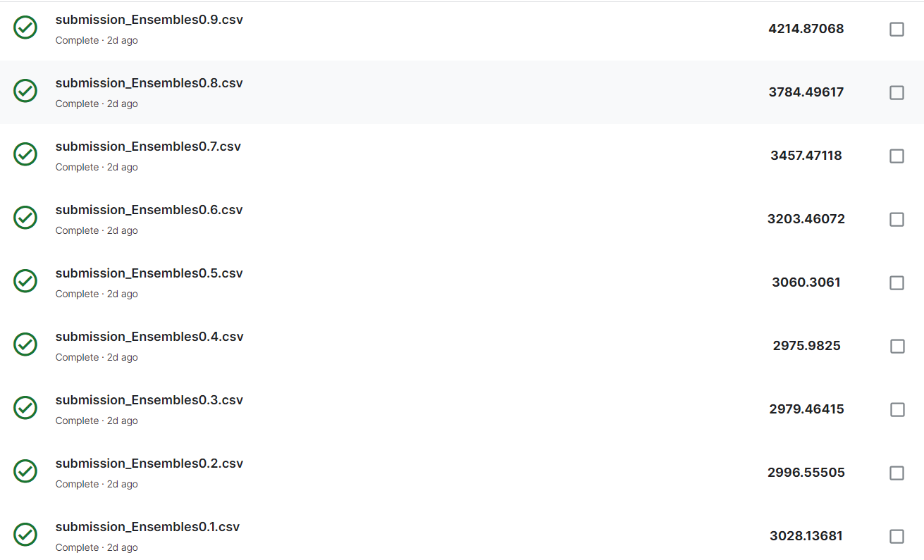
Ensemble by weighted average
Give two models different weights to check how different weights will impact the predictions
Hypothesis: giving more weights to non-financial model will get better result
A higher weights on non-financial model than on financial indeed will get a lower score
The best performance shows when financial model is given 0.4 weights and non-financial model is given 0.6 weights.

Slide 39
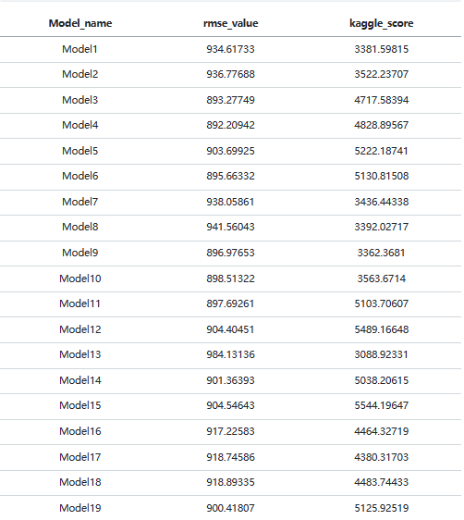
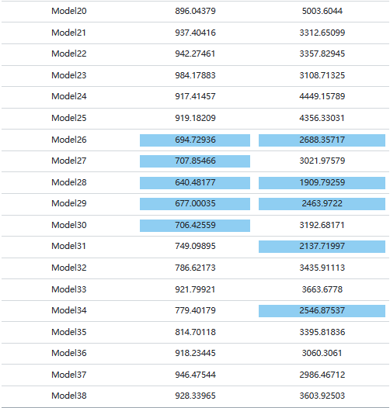

Slide 40
Conclusion
Machine learning elevates Model prediction accuracy
- XGBoost ranks the highest follow by Random Forest
- LASSO did not provide better prediction results than the non - financial model 3.
The choice of Advanced ML Alogrithm to use have to concurrent with domain knowledge understanding
Bias and variance trade-off
- The best performing model in train which means low bias is not corresponding to
the best out of sample which will give a high variance
We have to choose models we want depending on different goals.
Reasonable data is the base of accurate model building and prediction results.

Slide 41
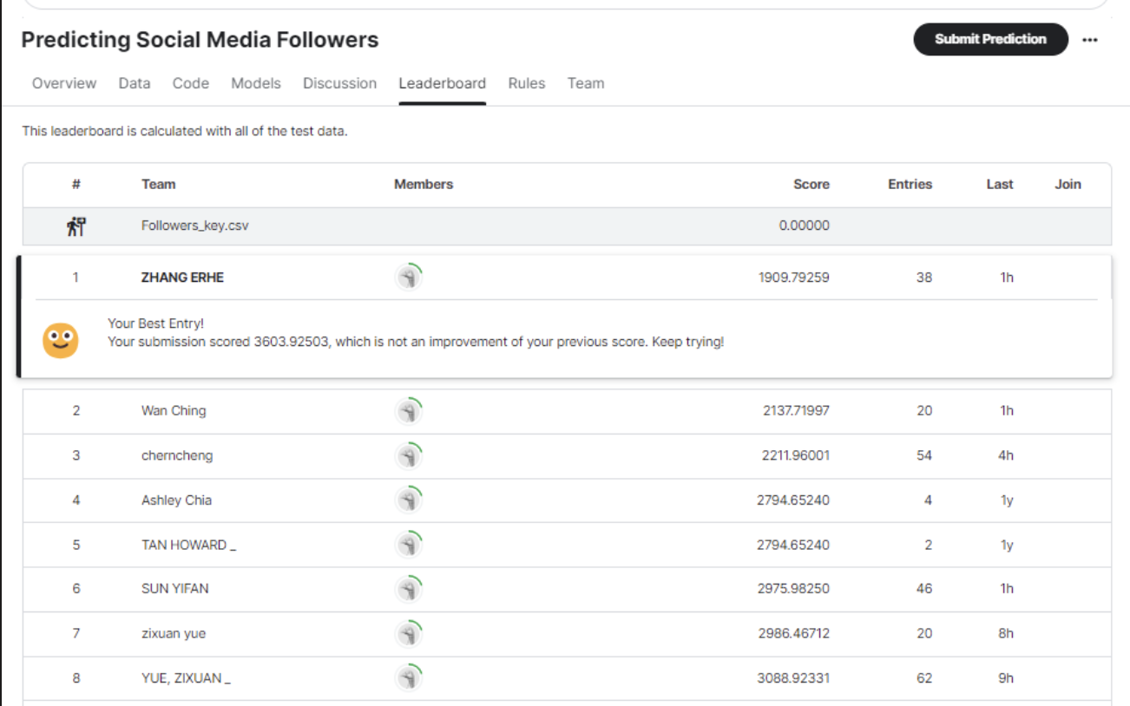
LeaderBoard Ranking

Slide 42
Thank you ！

